Slide 1
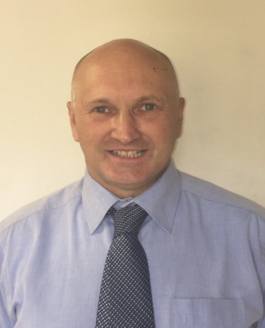
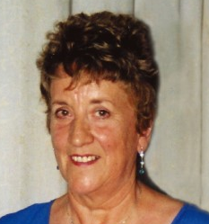
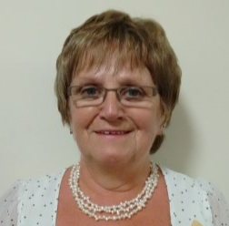
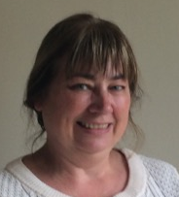
Inner Moray Firth North – Local Area Partnership
Tom grew up in Tain and was educated at Tain Royal Academy. After serving an apprenticeship as a mechanic and after various jobs in the oil industry he moved to Muir of Ord with his family and runs a local business.
He also chaired the Local Community Council for a period of time before starting work with the Scottish Court Service as a Justice of the Peace. His wish is to see money from the LEADER fund used to strengthen local community's with projects that are sustainable and leave a legacy for generations to come.
Tom Davis (Chair)
Betty has lived in the Highlands for over 30 years and was a Community Councillor for many of these. Her most important job was raising her own children and fostering another 80! She also ran a successful guesthouse, her main clients being from the nearby Admirality base.
Following intensive training, Betty was also a volunteer with the Alness Ctizens Advice Bureau for 13 years.
Betty is passionate about ongoing opportunities and training for young people in the Highlands and feels that the LEADER Programme is a way forward in enhancing the environment, employment and general wellbeing for the area
Betty Lochhead (Vice-Chair)
Jennifer grew up in Strathpeffer and was married to the late Billy Barclay, a farmer, for 44 years. They ran Boggiewell Farm together till his death 3 years ago and raised 4 children. She has been an active member in the local Congregational Church for many years and as a Christian enjoys the fellowship and support of friends there.
The Black Isle community is very close to Jennifer's heart; the younger generation, housing, education, safer routes to school, and the state of local roads are all part of what she would like to see improved. Jennifer enjoys serving with Leader as it helps with very important issues locally.
Councillor Jennifer Barclay
Helen has spent over 30 years working in the social housing sector across the Highlands and Islands. She now runs her own business; providing consultancy services for a range of organisations with strong community interests. Helen is an active member of the North Kessock community, a former chair of the Primary School Parent Council and currently a member of Knockbain Community Council. She is also a Board member for Cairn Housing Association. She sees community led projects as an important way of developing opportunities to sustain and strengthen local employment and services.
In her spare time Helen is studying Highlands and Islands History at UHI. She also enjoys gardening, reading, live music and theatre performances, and sings with Inverness Choral Society.
Helen Barton

Slide 2
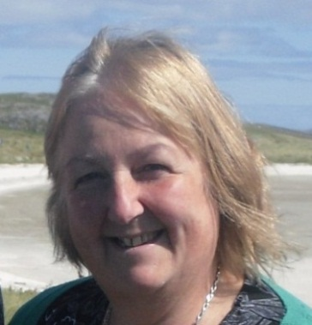
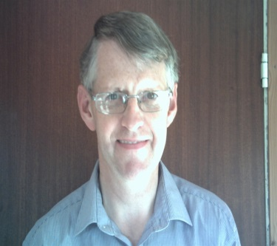
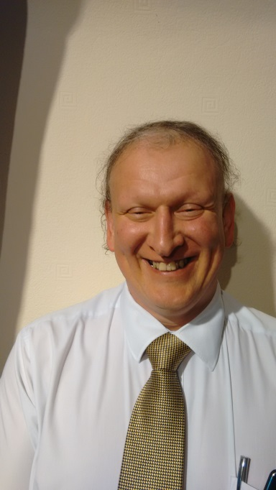
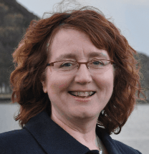
Val has been the CEO for Ross-Shire Voluntary Action since 2012, which is an organisation who work directly in community sustainability and development. Val has many years’ experience working in the Third Sector and with voluntary organisations alongside experience of working for both large and small charitable companies. With a strong focus on business management, and as a member of CMI, she is able to provide support and advice to voluntary organisations and social enterprises across the area.. Val is new to the Leader LAG this year and is well placed to understand the issues faced by local communities and the importance of further development.
Val Cameron
Sheila is a transport professional working from her home office in Evanton. She has, until recently, been employed by the Community Transport Association supporting community projects throughout Scotland.
Sheila also holds a public appointment on the Mobility and Access Committee for Scotland and sits on the Boards of Ross-shire Voluntary Action, Ross and Cromarty Disabled Access Group and the Bradbury Centre, Bonar Bridge. She spends her free time with her husband and large family, walks her 3 dogs and is a keen crafter.
Sheila Fletcher
I have lived in the Highlands since 2004 and since 2007 I have been the Chairman of the Balintore & District Residents Group. We manage a small community hall that is very well used for a wide range of activities such as a work club, youth club, lunch club and holiday play scheme. We also work with the Highland Council as the landlord of our 200 address social housing estate. Many local residents have volunteered to help at events but as in many places, we are challenged in getting regular committee members. Investment from Leader previously has helped improve our community so I look forward to helping other communities benefit from this round of grants.
Robert James
Derek Louden grew up and went to school in Tain. He was elected to Highland Council in May of 2017 after serving for seven years on the Royal Burgh of Tain Community Council. Derek is Treasurer and a Trustee of Tain & District Museum and a Director of Tain Heritage Trust.
He was a Director & Shareholder in local IT firm ITP Solutions from 2010 to 2015. Derek also taught on four degree programmes at Inverness College from 1992 to 1999 as the College worked towards the university status it enjoys today.
Derek has a keen interest in Oil & Gas and also in renewables and has worked on a number of renewable schemes for different communities.
At Highland Council Derek is a member of the Highland Opportunity Investments Ltd Board which supports business growth. He also sits on the Audit and Scrutiny Committee. He’s a new (albeit not fresh) face on the LEADER Local Area Partnership.
Councillor Derek Louden
Angela MacLean has been a local councillor since 2003 and is the member for Dingwall & Seaforth Ward. Angela has chaired the Community Safety and Public Engagement Committee at Highland Council and sits on the Boards of Ross & Cromarty CAB and Ross-shire Woman’s Aid.
Before becoming a Highland Councillor Angela worked in the finance Industry and she has held various posts on her local Community Council. Angela understands the important role community councils play in improving their local community and believes they are an undervalued and underappreciated resource who work to make their area better . Angela originally from Glasgow is married and has lived in the village of Maryburgh for 34 years. Given her council role Angela feels she is well placed to understand the needs of local communities
Councillor Angela MacLean

Slide 3
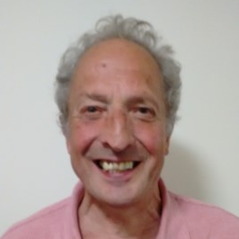
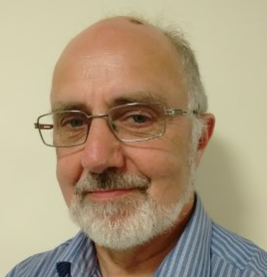
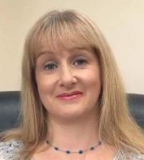
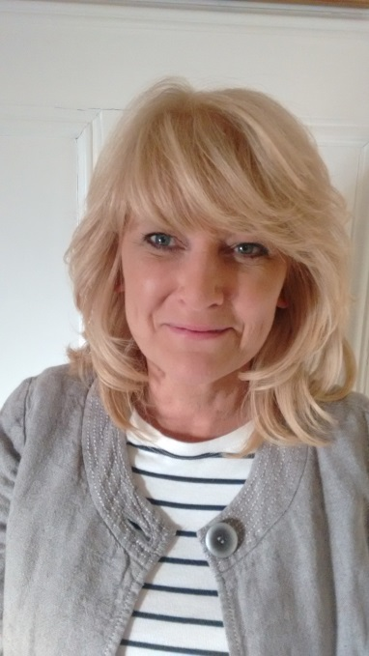
Iain is a retired Chartered Surveyor and is currently Vice Chair of Ferintosh Community Council on the Black Isle. He started work as an Assessors Department Rating Surveyor and moved into the Private Sector managing Commercial Property Companies eventually becoming self-employed.
Iain was especially interested in Business Start Up and Amenity Improvement securing EU Assistance which led to membership the East of Scotland European Partnership LBI Advisory Committee.
The improvement of Local Amenities and Conditions is a continuing interest.
Iain McCallum
John has lived in the highlands for 55 years and has worked for the Council for 44 years, currently employed within the Councils Housing Development section.
John has been involved in various community development activities in and around Evanton and the wider Ross-shire area and is currently secretary of Kiltearn Community Council. He is married with 3 grown up children and 3 grand-children.
John McHardy
Jillian is a Chartered Accountant originally from Sutherland now living in the Black Isle. She has a farming background which she puts to good use in her accountancy practice, Frame Kennedy, which she runs with her 2 fellow directors in Inverness. She has her own portfolio of clients ranging from large multi-million pound businesses to the local window cleaner and lists her specialisms as farming, tourism and family businesses.
Jillian has 2 children, both in Fortrose Academy and between them, and the various community concerns that she has volunteered for has little free time to follow her hobbies which include foreign travel, badminton and theatre.
Jillian Munro
Councillor Pauline Munro

Slide 4
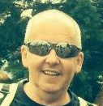
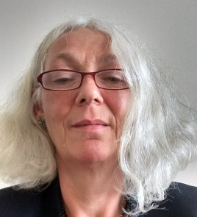
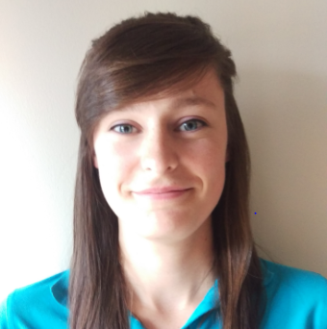
F firmly believes in supporting her community, particularly in social enterprise. She has lived in, and had connections with, the Invergordon area all her life. When she retired she felt that being on the LEADER Local Area Partnership would be an excellent opportunity to get involved and give something back. To date she has found the LEADER process very interesting and is enjoying the opportunity to support local initiatives.
F Reid
Gordon is currently an English Teacher at Alness Academy and is a member of the Alness Academy Parent Council. Prior to studying with the Open University, Gordon was a welder and a farmer. He is married with two sons and has always lived in Easter Ross.
Gordon is also Chairperson of The Place, Leader of Alness Academy Rock Challenge.
Gordon Robertson
Helen Ross works for Highland Council as Senior Ward Manager for Caithness, Sutherland and Easter Ross and is Ward Manager for the Cromarty Firth and the Tain & Easter Ross Wards. As a local Ward Manager she works closely with local Members and Community Groups and has experience of the previous LEADER Programme and community development.
From 1988 – 2007 Helen worked for the Council’s Housing Service. This included working closely with tenant and resident groups as well as delivery of front line services and policy and strategy development.
Helen Ross
Karla is a part-time Youth Development Officer in Alness and has been involved in youth work for 6 years. She is employed by Highlife Highland and also does sessional youth work in Charleston and Dingwall. Karla lives in Muir of Ord and has done her whole life.
Upon leaving school Karla studied at the UHI Inverness, completing a HND Sports Coaching qualification before attaining a BA (Hons) Sports Management Degree.
Karla Urquhart
The LAP has three voting youth members. Alness Youth Forum is represented by two members who attend LAP meetings on a rotational basis. A member of the Dingwall Youth Forum also sits on the LAP.
The Forums meets weekly, to raise, discuss and address issues which affect the young people of Alness and Dingwall, respectively. The forums generally comprise circa 10 members all between the ages of 12 and 18 years. At present the Alness forum is involved in the organisation of youth club and Fusion activities in Alness and is in the process of redecorating the youth space; ‘The Place’. Members are also involved in a Mental Health Project with the Ross and Cromarty Youth Forum which aims to tackle to stigma of Mental Health. The Dingwall forum is involved in fundraising for Fusion events and in a number of school and community events.
Highland Youth Parliament Representatives are also members of both youth forums.
Youth Representatives

